Slide 1

Spring - 1 Hotel Management System
(one to many relationship between Customer and Reservation in a hotel management)

Slide 2
Introduction
The “Hotel Management System” has been developed to override the problems prevailing in the manual system. So that their valuable data/information can be stored for a longer period with easy accessing and manipulating of the same. The main objective of the project on Hotel Management System is to manage the details of Room, Customer, Reservation, Hotels, Services and Billing.
The purpose of the project is to reduce the manual work for managing all the information about Room, Customer , Reservation, and Billing.

Slide 3
Implementation
Mapping java Entities for persistence in hibernate
Checked in junit including positive test case
Proper commenting have been done
CRUD Reservation, Customer, Rooms, Hotels, Services and Billing are also implemented

Slide 4
Observation
Maven Dependencies :
import jakarta.persistence.Column;
import jakarta.persistence.Entity;
import jakarta.persistence.GeneratedValue;
import jakarta.persistence.GenerationType;
import jakarta.persistence.Id;
import jakarta.persistence.JoinColumn;
import jakarta.persistence.ManyToOne;
import jakarta.persistence.Table;
import jakarta.persistence.EntityManager;
import jakarta.persistence.EntityManagerFactory;
import jakarta.persistence.Persistence;

Slide 5
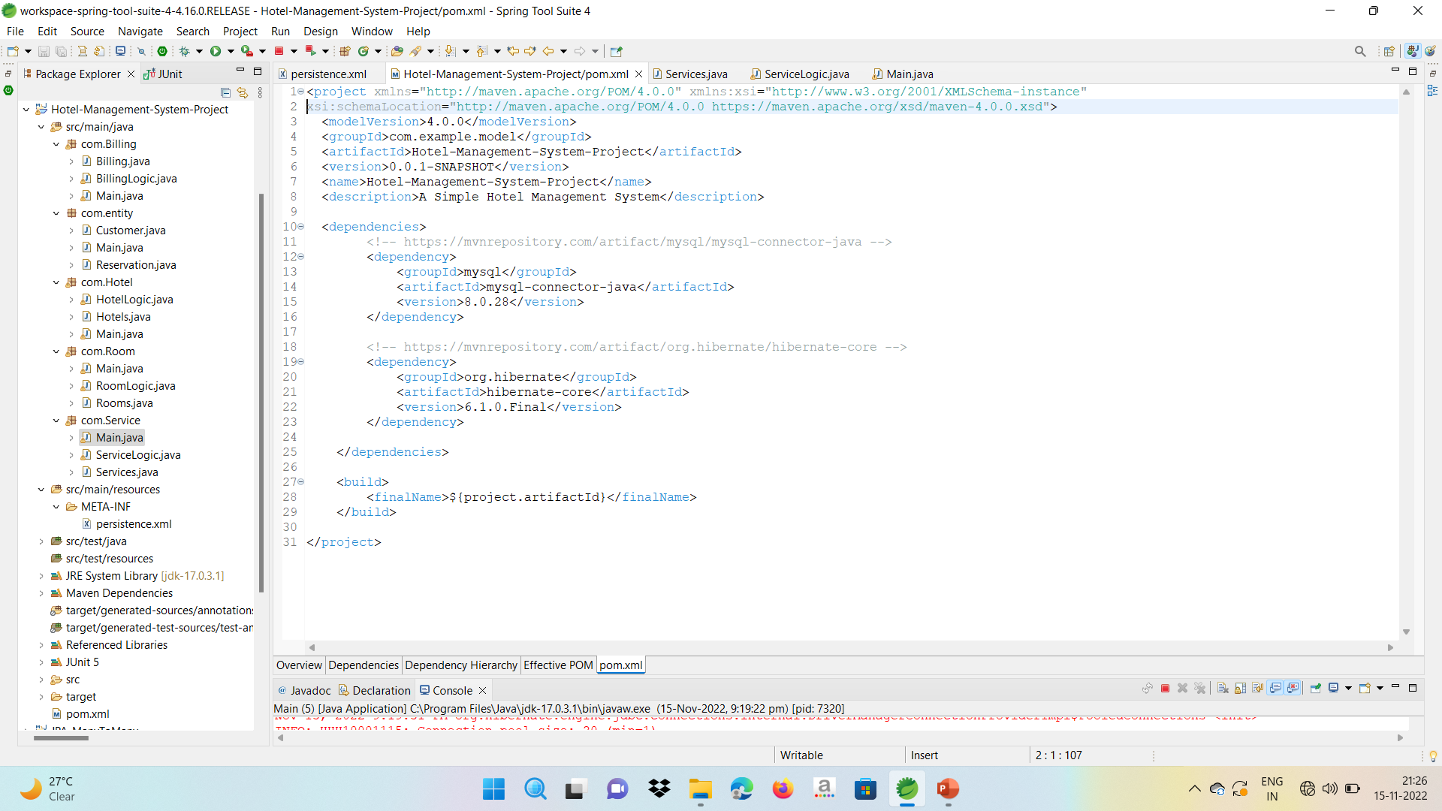
Pom.xml File

Slide 6
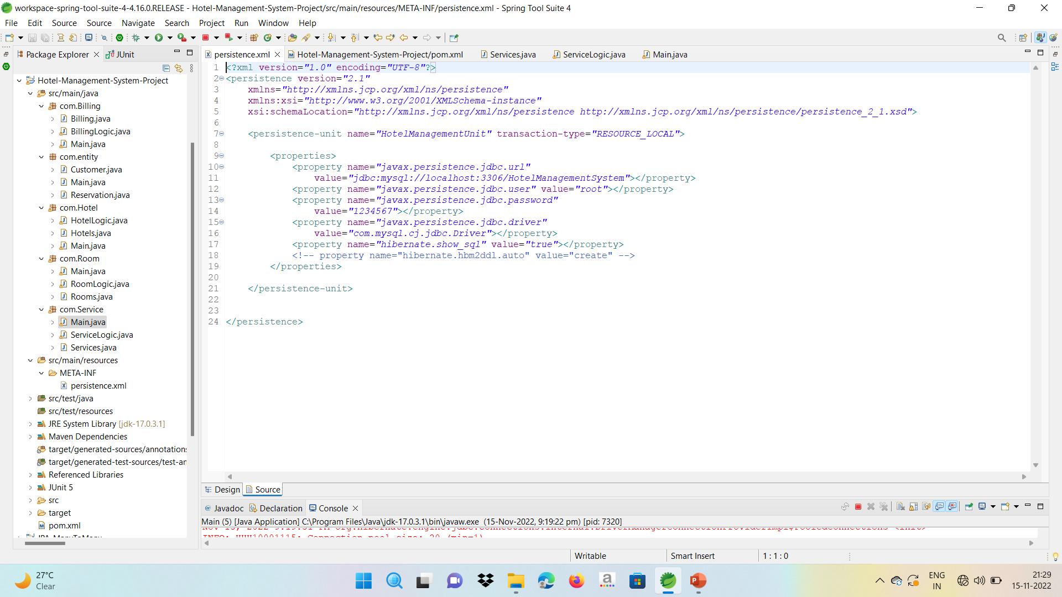
Persistence File

Slide 7
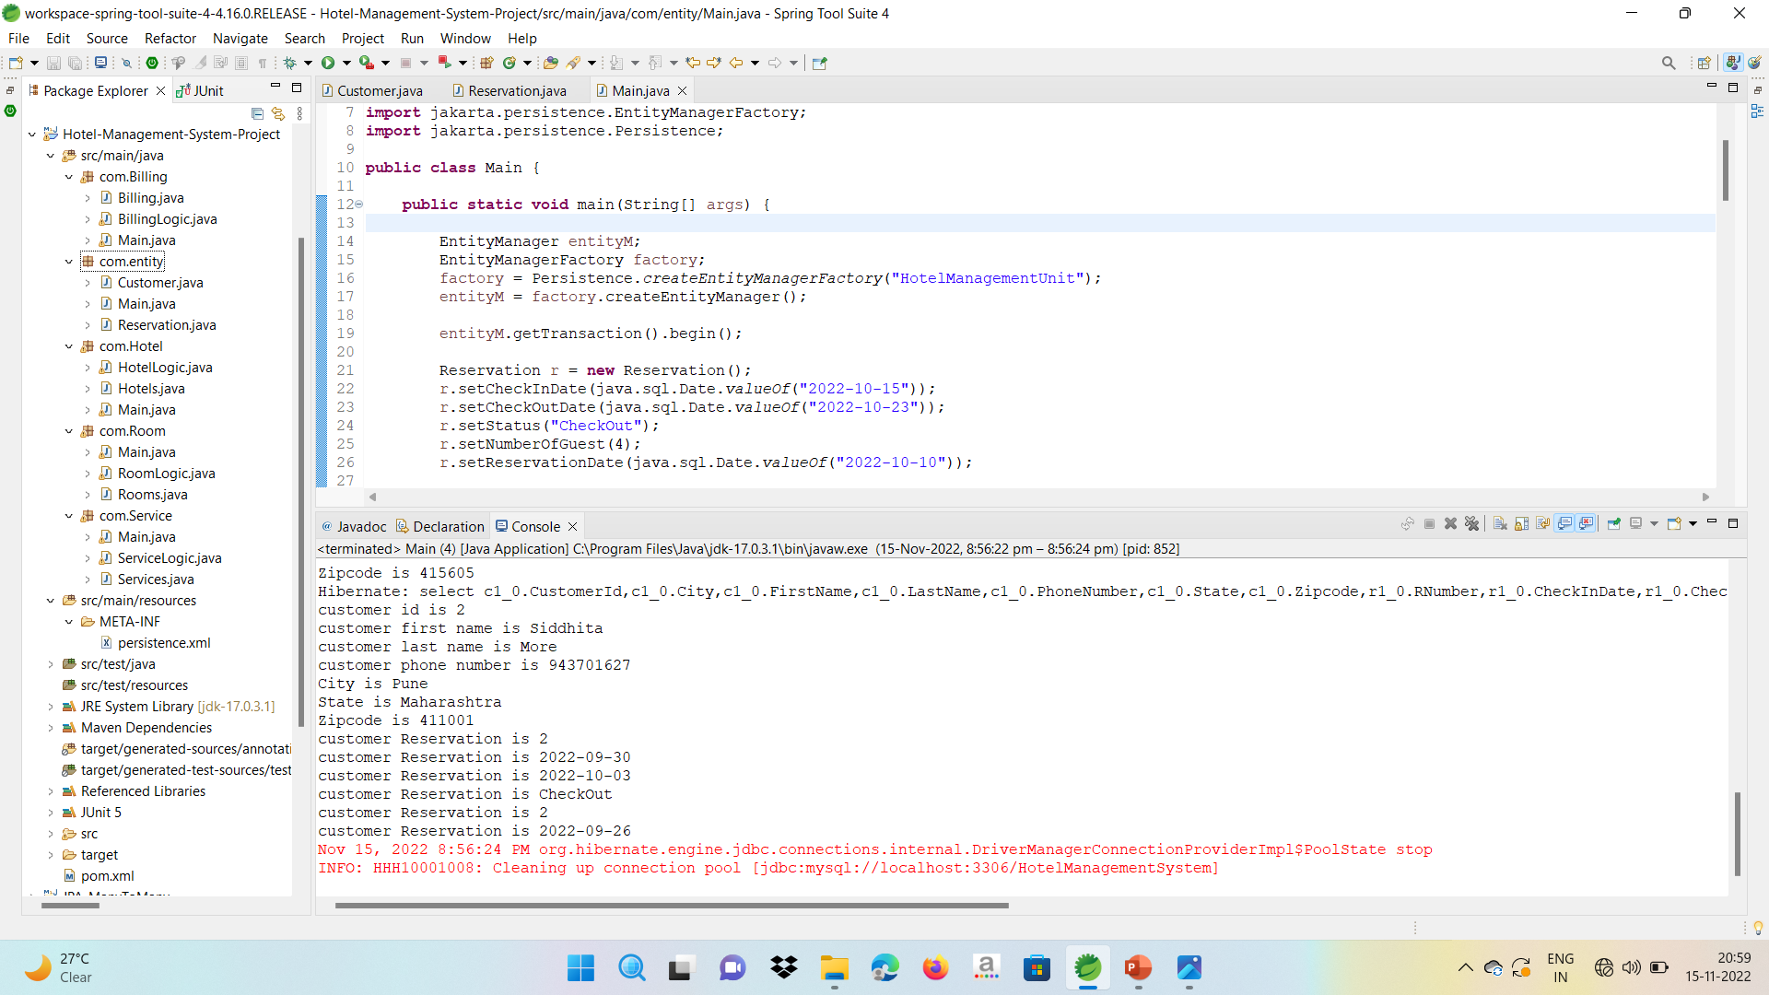
Starting from Customer Reservation and Customer Details

Slide 8
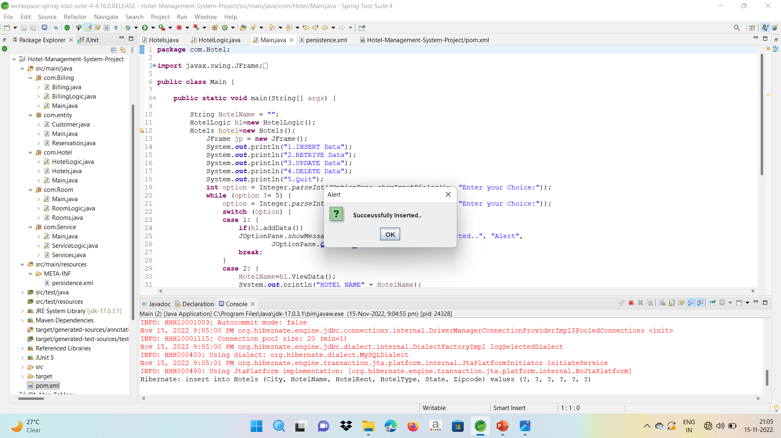
Inserting Hotels Details

Slide 9
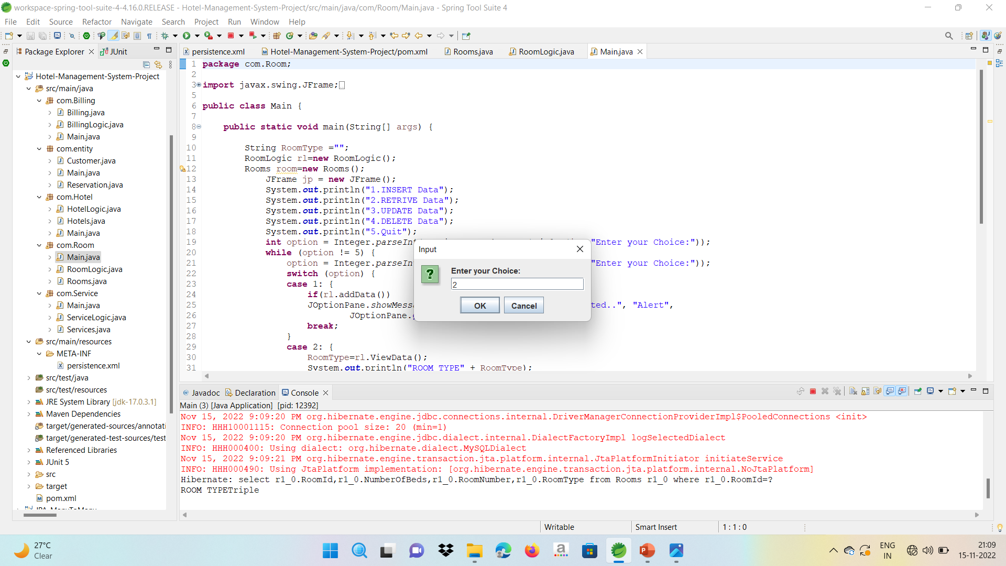
Retrive the Room Type

Slide 10
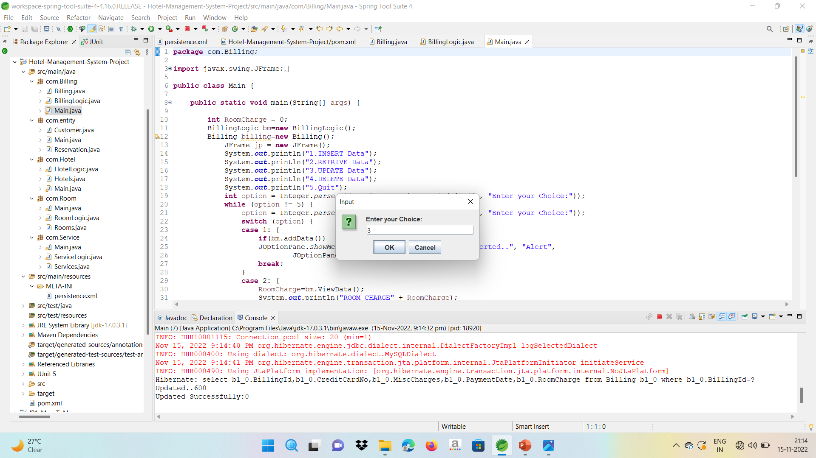
Updated Billing

Slide 11
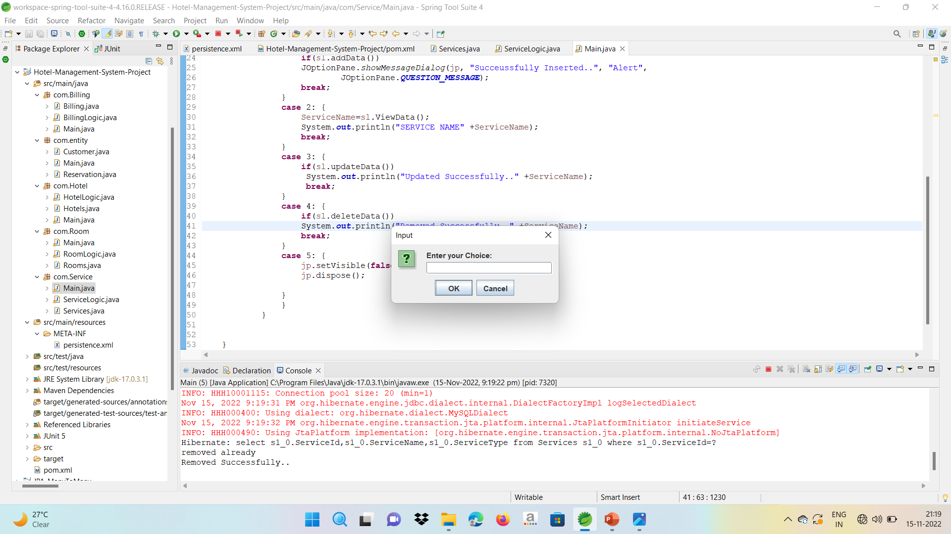
Services Deleted

Slide 12
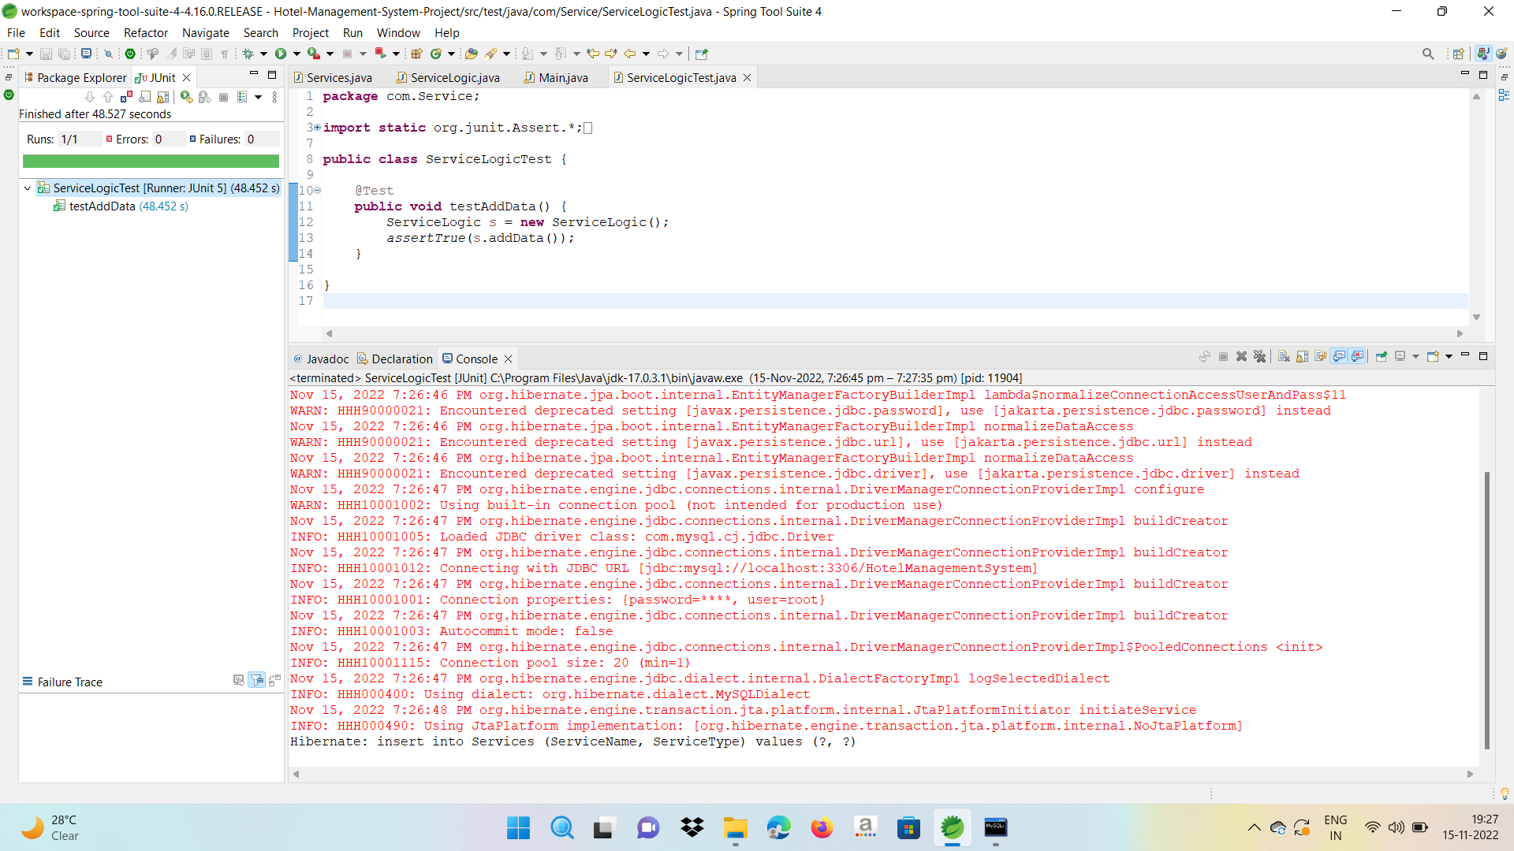
Positive test case

Slide 13
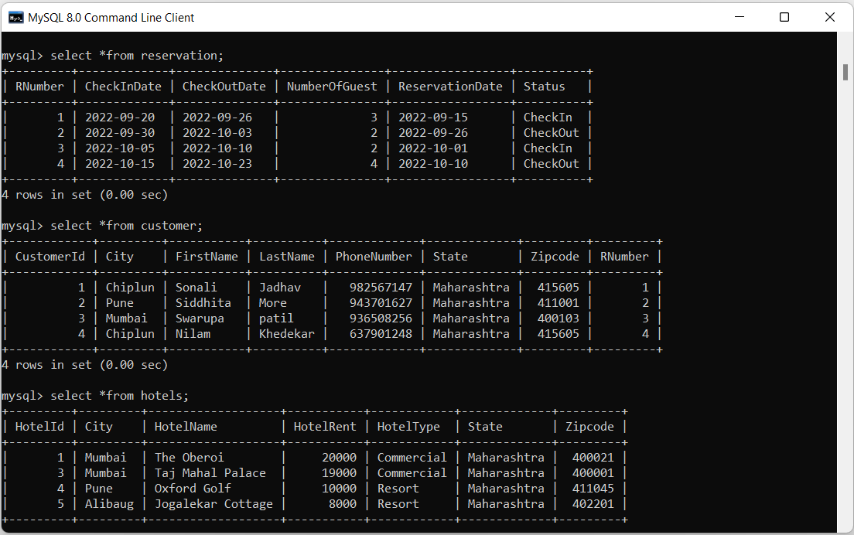
MySQL Database Table

Slide 14
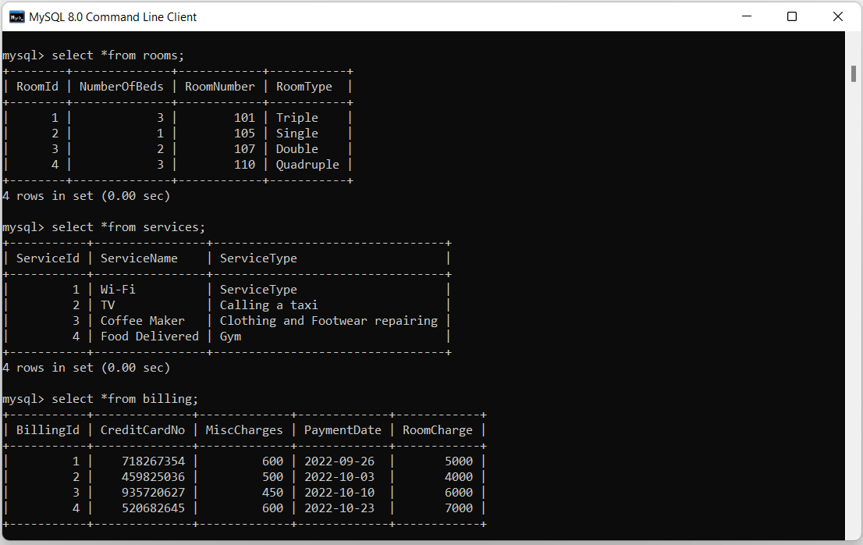
MySQL Database Table

Slide 15
Future Enhancements
We can give more facilities for Hotel Management System . The above mentioned points are the enhancements which can be done to increase the applicability and usage of this project . here we can maintain the records of Room and Customer . so there is a scope for introducing a method to maintain the Hotel Management System . Enhancement can be done to maintain all the Room, Customer, Reservation , Hotel, Services and billing.

